Slide 1

HISTOPATHOLOGIC CANCER DETECTION
SHASHANK GUPTA, DONGHUI LI, YINGJUN ZHONG, YUQING ZHENG, JAY TRIVEDI

Slide 2

Table of Contents
Introduction
Background
Exploratory Data analysis
Data Preprocessing
Modelling
Problem Encountered
Evaluation
Summary

Slide 3
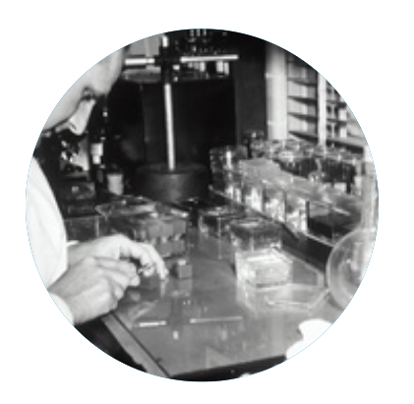
Introduction
Cancer is a major healthcare issue, responsible for one in six deaths globally. Identifying the presence of metastatic tissue from histopathologic scans is challenging and time-consuming. Our project aims to create binary classification models to improve the accuracy of cancer detection using 96*96 digital histopathology images of lymph nodes. We will evaluate different algorithms and their strengths and weaknesses.

Slide 4

BACKGROUND
Disadvantages of manual check on pathologic images:
Time-consuming and labor-intensive
Subjectivity and variability
Fatigue and errors
Limited scalability

Slide 5
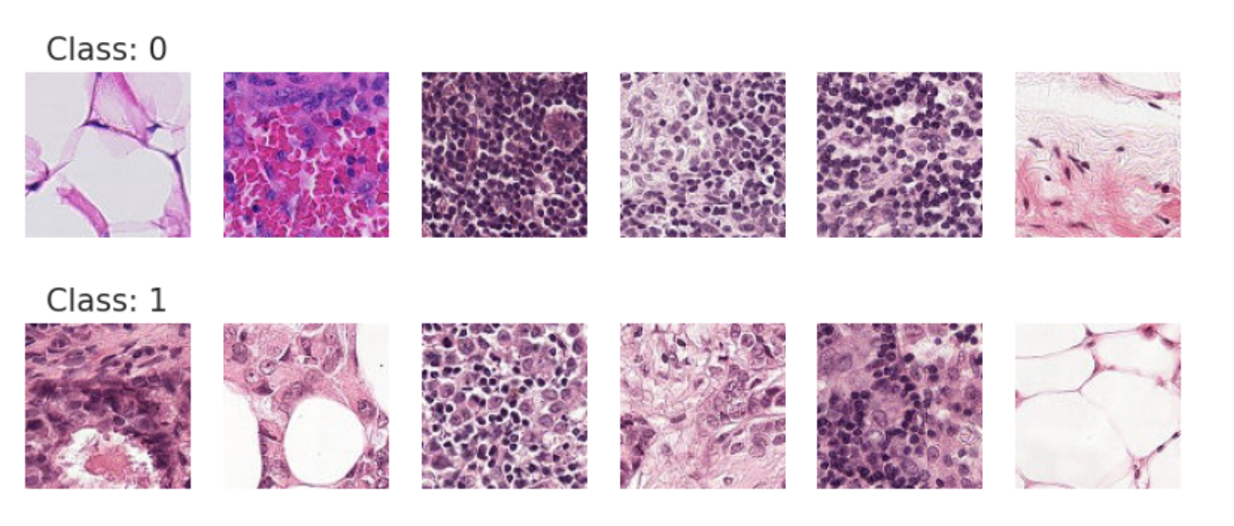
DATA ANALYSIS
This original dataset has no duplicates, and contains close to 280 thousand of 96*96 digital histopathology images split into the following two datasets.
Testing sets (contains 57,458 images labeled 0)
Training sets (includes a total of 220,025 pictures, 59.5% were labeled 0 and 40.5% were labeled 1)
We are also given a CSV file which contains 2 variables, includes 1 feature (picture id) and 1 target (label)

Slide 6
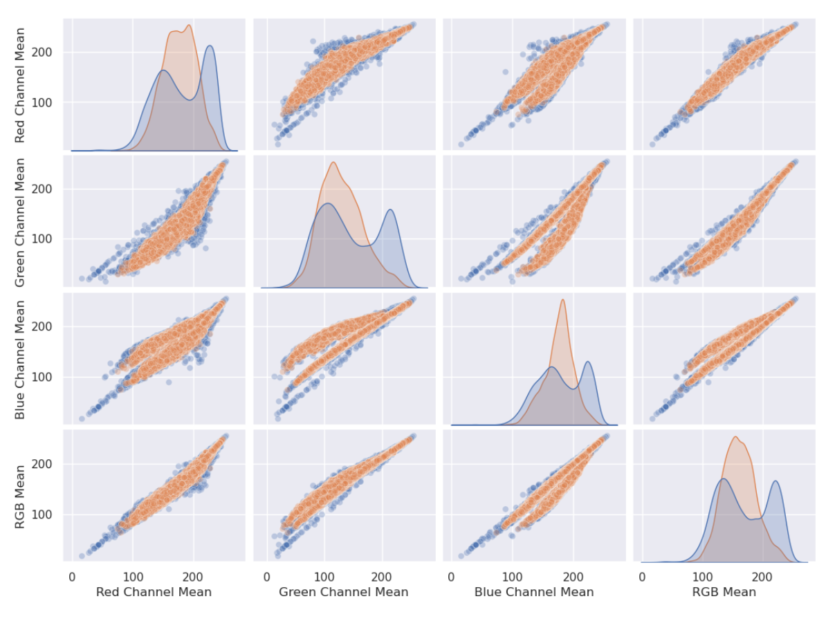
EXPLORATORY DATA ANALYSIS - RGB channels
benign
malignant
Observation:
Malignant - larger range of variation
Benign - uniformly distributed
Insights:
Such variations may be related to the abnormal proliferation of cancer cells in tissues, which may lead to higher chromatin content and metabolic activity levels

Slide 7
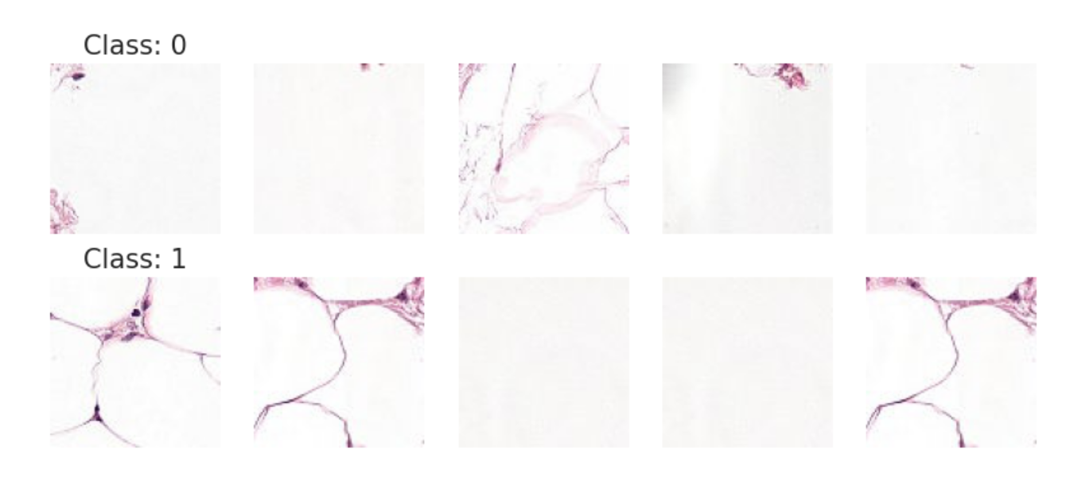
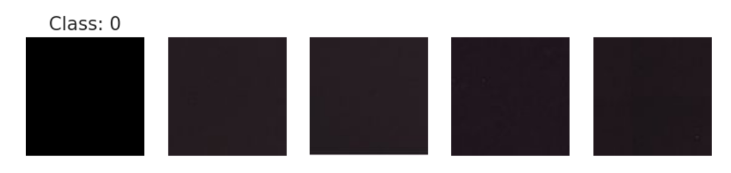
DATA PREPROCESSING – Outliers
Outliers can lead to incorrect conclusions about the data and affect the accuracy of predictive models
if ((RGB <= 45) or (RGB >= 245)) : outliers.append(meta_data.loc[meta_data['path'] == path].index[0])
 | before | after
Class 0 | 10000 | 9907
Class 1 | 10000 | 9997

Slide 8
DATA PREPROCESSING - Data Augmentation & Normalization
To help our models gain better understanding of the images and features, we apply data augmentation techniques such as cropping, rotation, flip, normalization, etc to diversified our data.
We applied normalization to the image data, which scales the pixel values of each channel to zero mean and unit variance. Normalization can help to prevent the effect of different scales of pixel values on the performance of machine learning models, and can improve the convergence rate and accuracy of the model during training.
Transformations | Training Set | Testing Set
Random Resized Image Cropping | Applied | Resize Only
Image Rotations | Applied | Not Applied
Random Horizontal Flip | Applied | Not Applied
Center Cropping | Applied | Applied
Image Normalization | Applied | Applied

Slide 9
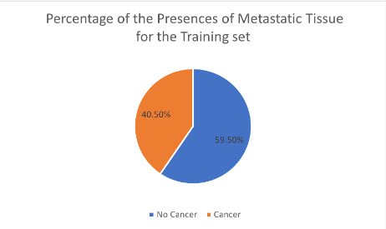
DATA PREPROCESSING – Data Sample and Balancing
As mentioned early, the dataset is not balanced between the two label, with 59.5% being 0 and 40.5% being 1)
To ensure that our models have a good understanding of both classes, we draw an equal sample from both classes to create the training and testing dataset.
Due to the long training time of the models, we sample 2500 images from each class to use it as the training data. (We will train the models with more data once everything is set)

Slide 10
MODEL SELECTION
Basic model: we start with the basic classification models as baselines to help us better understand the advantages of the neural network, especially in image classification
Naive Bayes,
K-Nearest Neighbor
Decision Tree
Custom CNN using torch
Pretrained model: the main focus of this project, as these models have been trained on large datasets, they can leverage the knowledge from previous training to more effectively learn and predict in the new task.
ResNet50
DenseNet121
VGG19 & VGG16.
Ensemble model: aggregate 4 pretrained models with custom weights to enhance predicting power

Slide 11
DIFFERENT MODELS USED – BASIC MODELS
For Naive Bayes classifier, we set the min_categories set to 256 to represent the RGB color value range.
For KNN, we hyper-tuned the n_neighbors for the range 12 to 50.
Best n_neighbors = 18
For the Decision Tree, we hyper-tuned the max_depth, splitter, and criterion.
Best max_depth = 9
Best splitter = “best”
Best criterion = “gini”
 | KNN | Decision Tree | Naive Bayes
Training Accuracy | 0.6570 | 0.7239 | 0.7172
Test Accuracy | 0.6402 | 0.6829 | 0.7094

Slide 12
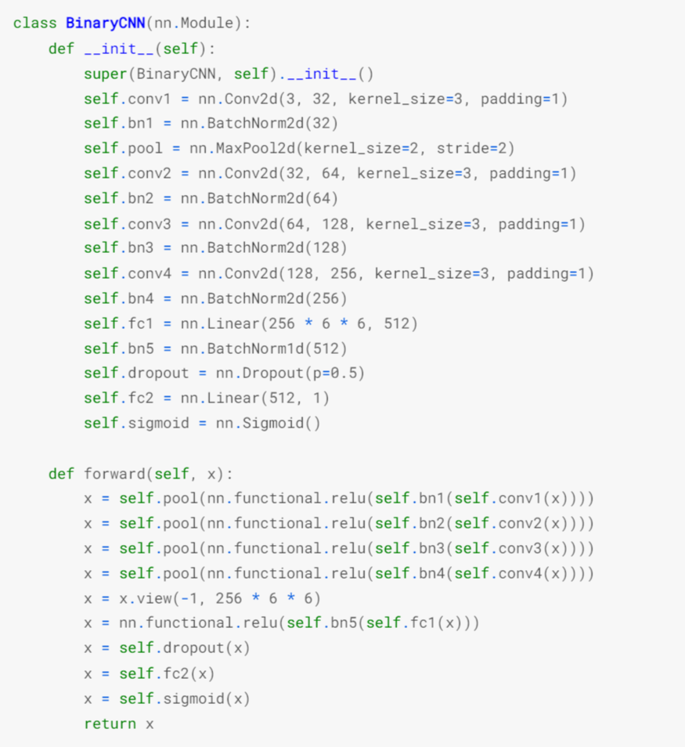
DIFFERENT MODELS USED
– CUSTOM MODEL
Custom Model architecture
4 convolutions layers with batch normalization
Relu as activation function
Dropout to avoid overfitting
Sigmoid for binary classification
Notes:
In the given code, self.dropout is a dropout layer with a dropout probability of 0.5, which means that during training, each neuron in the preceding layer will have a 50% chance of being dropped out. This helps to prevent overfitting and improve the generalization ability of the model.
The main advantage of batch normalization is that it can help to overcome the vanishing gradient problem, which can occur in deep neural networks when the gradients become too small during backpropagation, making it difficult for the network to learn. By normalizing the inputs of each layer, batch normalization can help to stabilize the distribution of gradients flowing through the network, making it easier to train deep networks.
In addition to improving the stability of the network, batch normalization can also lead to faster training times and improved generalization performance by reducing the dependence of the network on the initial values of the weights and biases. This is because the normalization of the inputs reduces the impact of the scale of the weights and biases on the output of the layer.
Overall, batch normalization is a powerful technique for improving the performance and stability of neural networks, particularly in deep learning applications.

Slide 13
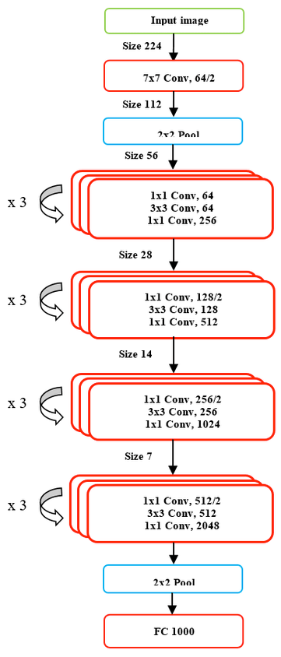
DIFFERENT MODELS USED - ResNet50
ResNet50 architecture
Key feature: Residual blocks that allow for very deep neural networks by mitigating the vanishing gradient problem.
Advantages:
Can train very deep neural networks with hundreds of layers.
Achieves state-of-the-art performance on a wide range of computer vision tasks.
Faster convergence and better generalization than traditional networks with the same number of layers.
Notes:
The architecture of ResNet50 consists of several residual blocks, each containing multiple convolutional layers, batch normalization layers, and shortcut connections. The shortcut connections, also called skip connections, enable the network to learn residual functions that help improve gradient flow and alleviate the vanishing gradient problem.
Each residual block in ResNet50 contains two or three convolutional layers with a kernel size of 3x3 and a stride of 1. The first convolutional layer is followed by a batch normalization layer and a ReLU activation function. The second and third convolutional layers (if present) also have batch normalization layers and ReLU activation functions. The shortcut connection is added to the output of the first convolutional layer and is added to the output of the last convolutional layer in the residual block.
ResNet50 also includes a global average pooling layer and a fully connected layer that produces the final output of the network. The global average pooling layer reduces the spatial dimensions of the feature maps to a single value for each channel. The fully connected layer produces a probability distribution over the classes.

Slide 14
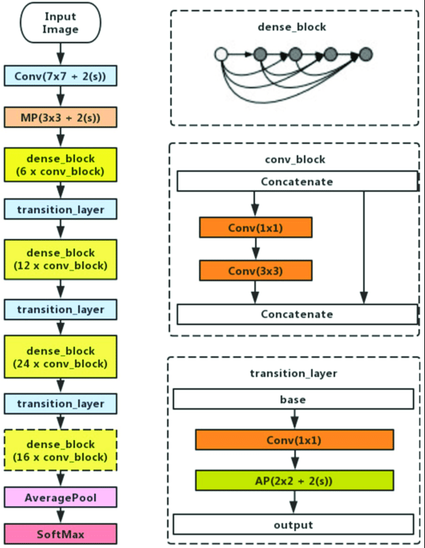
DIFFERENT MODELS USED
– DenseNet121
DenseNet-121 architecture with Default Weights.
Key feature: Dense blocks that allow for better feature reuse and gradient flow by densely connecting each layer to all subsequent layers in the block.
Advantages:
Achieves state-of-the-art performance on several computer vision tasks with a relatively small number of parameters.
Better accuracy and faster convergence than traditional networks with the same number of layers.
Can be more memory-efficient than traditional networks by reducing redundant feature maps.
Notes:
The DenseNet121 architecture consists of four dense blocks, with each block consisting of a number of convolutional layers followed by a batch normalization and a ReLU activation function. The output of each dense block is passed through a transition layer, which consists of a convolutional layer, batch normalization, and a pooling layer. The transition layer reduces the spatial dimensions of the feature maps while increasing the number of feature maps. The final layer of the network is a global average pooling layer, which averages the feature maps and produces a single feature vector, followed by a fully connected layer and a softmax activation function to produce the final classification output.

Slide 15
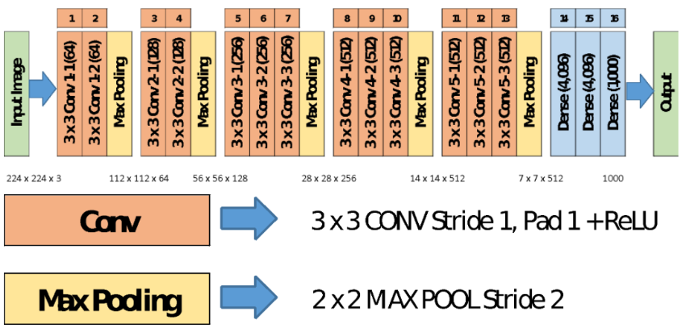
DIFFERENT MODELS USED – VGG19 & VGG16
VGG19 & VGG16 architecture
Key feature: Stacks of convolutional layers with small filter sizes and max pooling layers for spatial downsampling.
Advantages:
Simple and elegant architecture that is easy to understand and implement.
Achieves strong performance on several computer vision tasks.
Can serve as a good baseline architecture for comparing the performance of more complex models.
Notes:
The VGG16 architecture is composed of 13 convolutional layers, 5 max-pooling layers, and 3 fully connected layers. The first two convolutional layers have 64 filters, while the remaining convolutional layers have 128, 256, and 512 filters, respectively. The fully connected layers have 4096 units each. The VGG16 architecture is named after its 16 weight layers.
The VGG19 architecture is an extension of VGG16 and has 19 weight layers. It has the same basic structure as VGG16, but with more convolutional layers. Specifically, it has 16 convolutional layers, 5 max-pooling layers, and 3 fully connected layers. The additional convolutional layers are inserted between the existing ones, and have 64, 128, 256, and 512 filters, respectively.
Both VGG16 and VGG19 architectures use a fixed-size (224x224) input image, which is then passed through a series of convolutional layers with 3x3 filters and a stride of 1 pixel. Max-pooling layers are inserted after every two convolutional layers to reduce the spatial resolution by a factor of 2. The fully connected layers at the end of the network perform the classification. The VGG architectures use the rectified linear unit (ReLU) activation function, which has been shown to work well in deep neural networks.

Slide 16
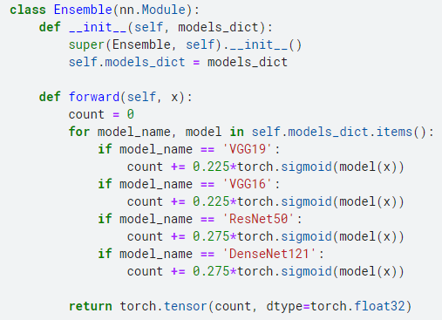
DIFFERENT MODELS USED – ENSEMBLE
Ensembled architecture
Key feature: By combining predictions from several models that have been trained on the same or different datasets, the ensemble can potentially produce more accurate and robust predictions than any individual model alone.
The weights are assigned based on the performance of each individual pretrained model.

Slide 17
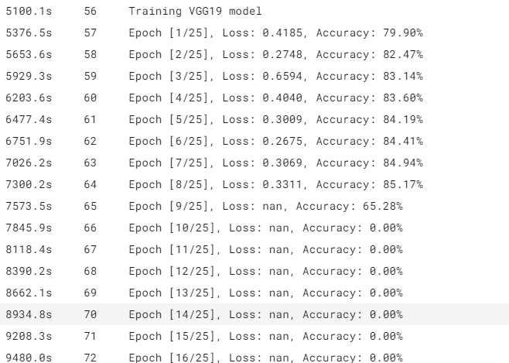
PROBLEM ENCOUNTERED
Overfitting: happens when training accuracy increases but test accuracy decrease
use scheduler to reduce learning upon validation loss reach a plateau
scheduler = torch.optim.lr_scheduler.ReduceLROnPlateau(optimizer, mode='min', factor=0.1, patience=3)
Exploding gradient: when gradient becomes too large and causes weight updates to overshoot
Use gradient clipping to limit gradient from exceeding threshold
nn.utils.clip_grad_norm_(model.parameters(), max_norm=1.0)
Notes:
Exploding gradients is a problem that can occur during the training of neural networks, particularly deep neural networks. It occurs when the gradients of the loss function with respect to the parameters become very large, causing the weight updates to also become very large. This can cause the weights to overshoot the optimal values, leading to instability in the training process and making it difficult or impossible for the network to converge to a good solution.
The problem of exploding gradients can occur in networks that use activation functions with large derivatives, such as the sigmoid function, and in networks with deep architectures, where the gradients can accumulate and become very large. To prevent exploding gradients, techniques such as gradient clipping, weight initialization, and batch normalization can be used. Gradient clipping involves scaling the gradients if their norm exceeds a certain threshold, while weight initialization involves initializing the weights with small values to prevent the gradients from becoming too large. Batch normalization involves normalizing the activations of each layer to have zero mean and unit variance, which can help to stabilize the gradients and improve the training process.

Slide 18
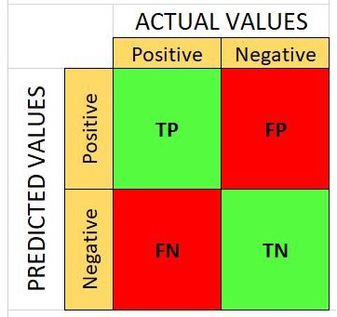
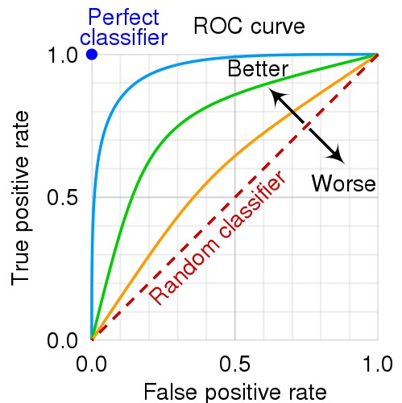
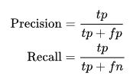
EVALUATION INDEX
Confusion Matrix
True negative (TN): Indicates the number of samples that are actually negative samples predicted as negative samples
False positive (FP): Indicates the number of samples that are actually negative samples predicted as positive samples
False negative (FN): Indicates the number of samples that are actually positive samples predicted to negative samples
True positive (TP): Indicates the number of samples that are actually positive samples predicted to be positive samples
ROC and AUC
In the ROC graph, the horizontal axis is the False Positive Rate (false positive rate, FPR), and the vertical axis is the True Positive Rate (TPR)
However, ROC curve is not intuitive enough to observe. We need the AUC (Area under the ROC curve) as an evaluation indicator.
AUC = 1, representing the perfect classifier
0.5 < AUC < 1, better than random classifiers
0 < AUC < 0.5, worse than a random classifiers

Slide 19


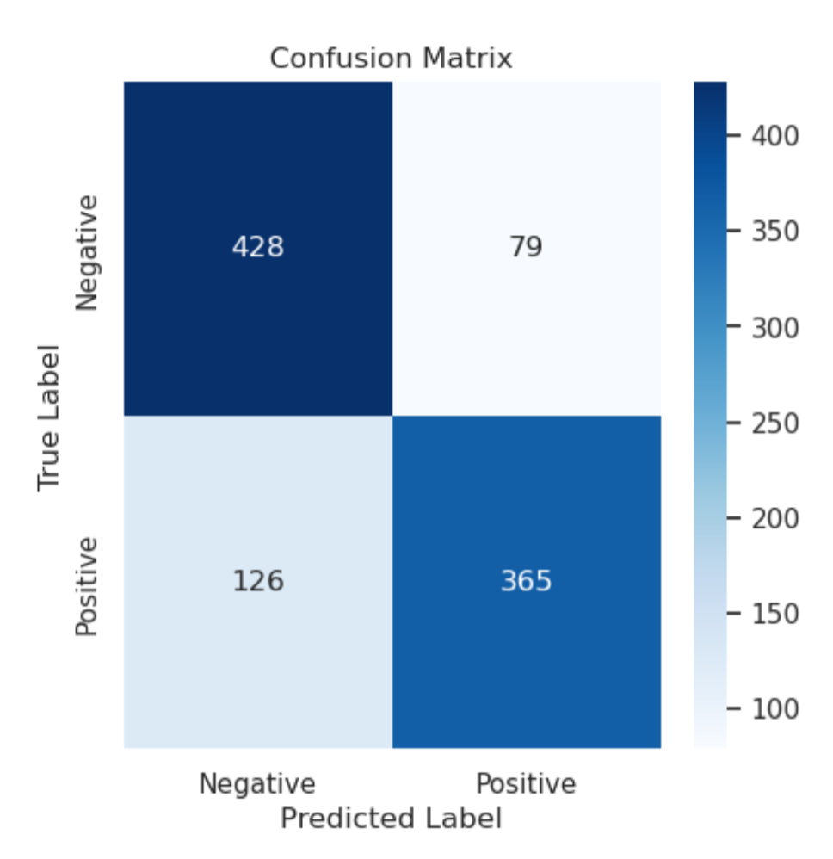
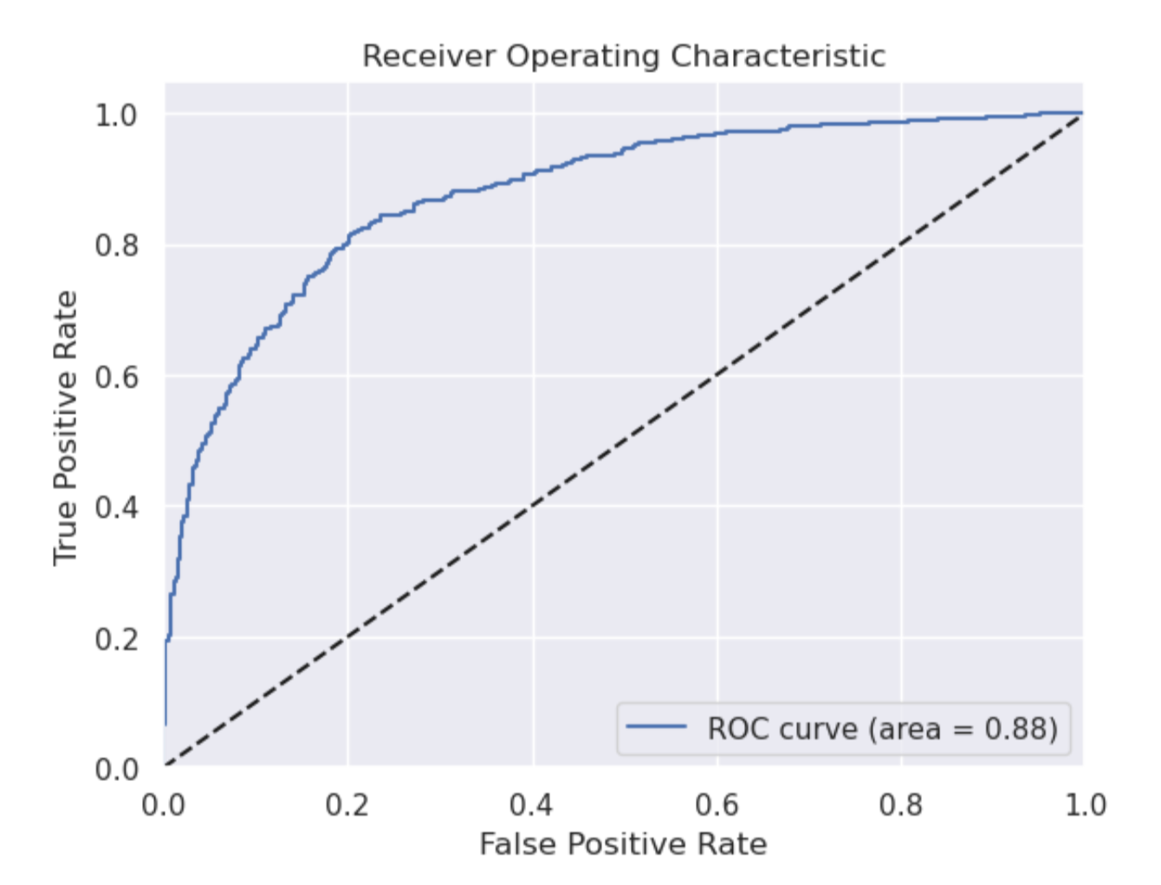
PERFORMANCE OF CUSTOM MODEL
Insights on Custom Model:
Relatively Fast in execution and training.
Achieved descent AUC ROC score of 88% and has considerable discriminatory power.
Achieved a accuracy of 79% and precision of 82.2%.

Slide 20
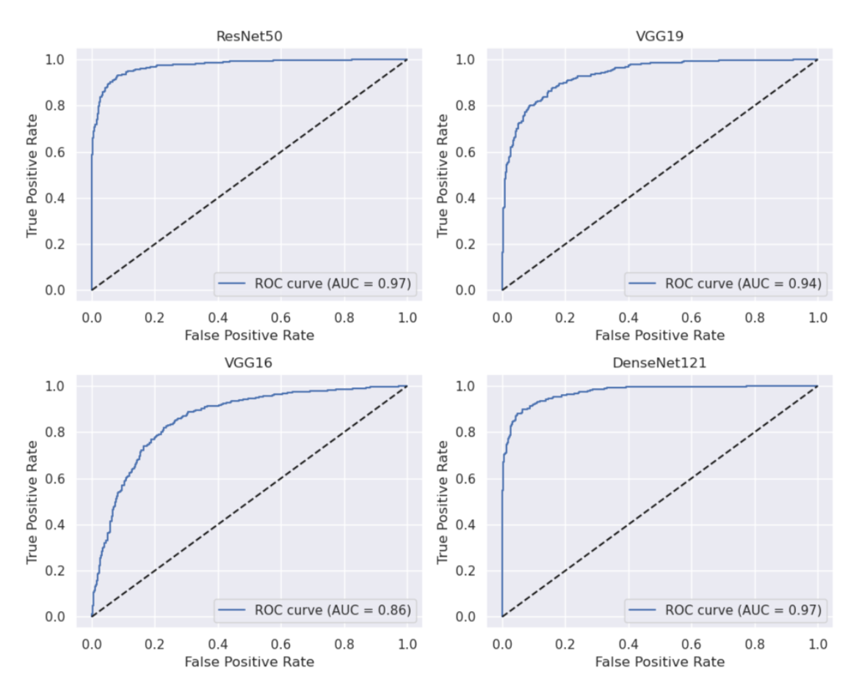
PERFORMANCE OF PRE-TRAINED MODELS
Performance Evaluation:
ResNet50 and DenseNet121 achieved the best AUC score of 0.97 each.
VGG19 and VGG16 models achieved AUC score of 0.94 and 0.86, respectively.

Slide 21
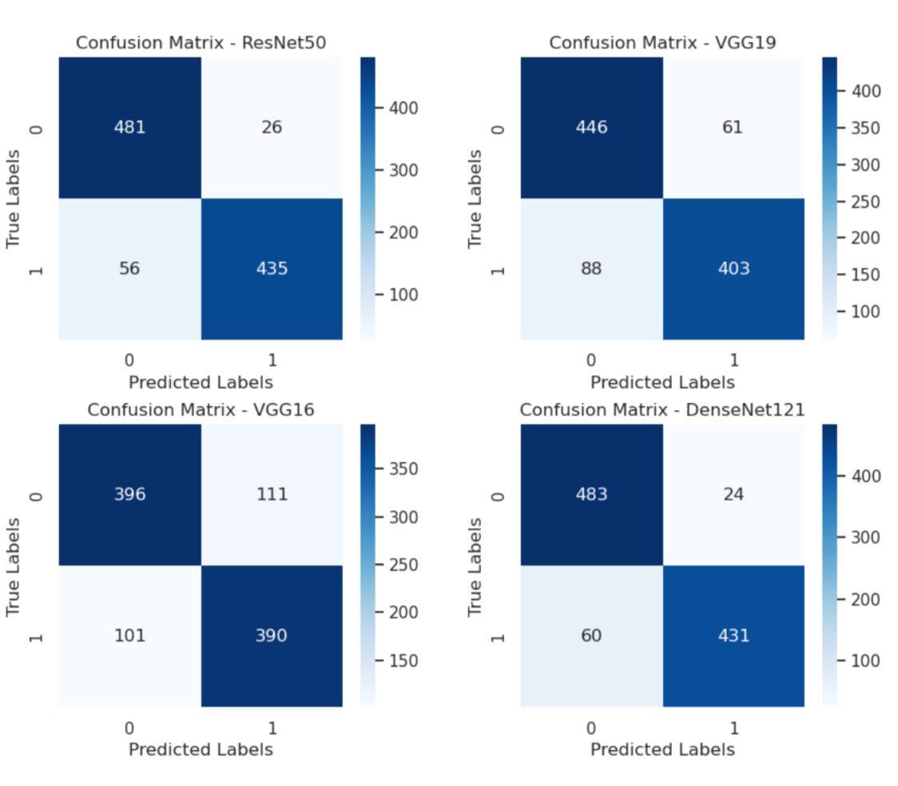
PERFORMANCE OF PRE-TRAINED MODELS (Continued)
Insights on Confusion Matrix:
DenseNet 121 offers best Precision by presenting low False Positives. Which is not relevant in our case.
ResNet50 offers the best Recall (88.59%) of all the pretrained models and is the preferred model in this case.
VGG16 predictions are relatively poor.

Slide 22
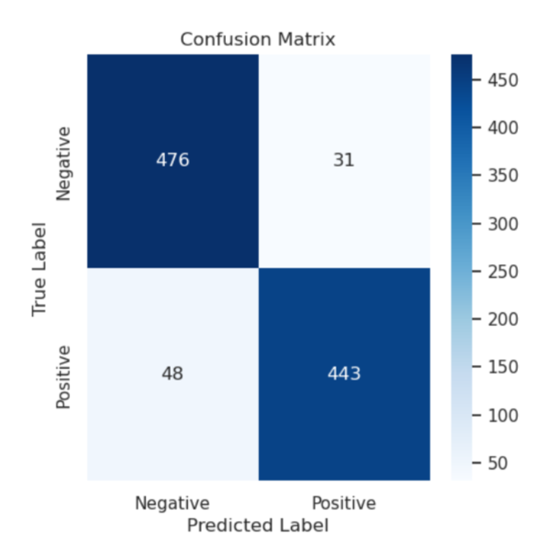
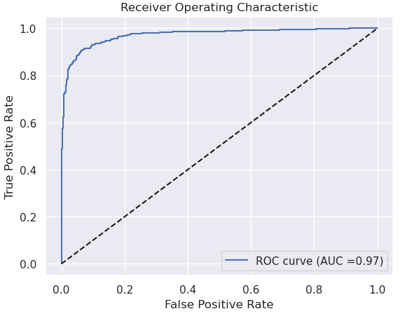
PERFORMANCE OF ENSEMBLE MODEL
Insights on Ensemble Model:
Achieved descent AUC ROC score of 97%
Achieved a accuracy of 92% and recall of 90.22%.

Slide 23
OVERALL PERFORMANCE EVALUATION
Models | Accuracy | Recall | Precision | AUC ROC
VGG19 | 85% | 82.07% | 86.85% | 94%
ResNet50 | 91% | 88.59% | 94.36% | 97%
DenseNet121 | 91% | 87.78% | 94.73% | 97%
VGG16 | 78% | 79.43% | 77.84% | 86%
Custom Model | 79% | 74.34% | 82.2% | 88%
Ensemble | 92% | 90.22% | 93.46% | 97%
Best Model
Notes:
This is only a small sample result by training with 5000 images. Report will include results with more training data (25000)

Slide 24
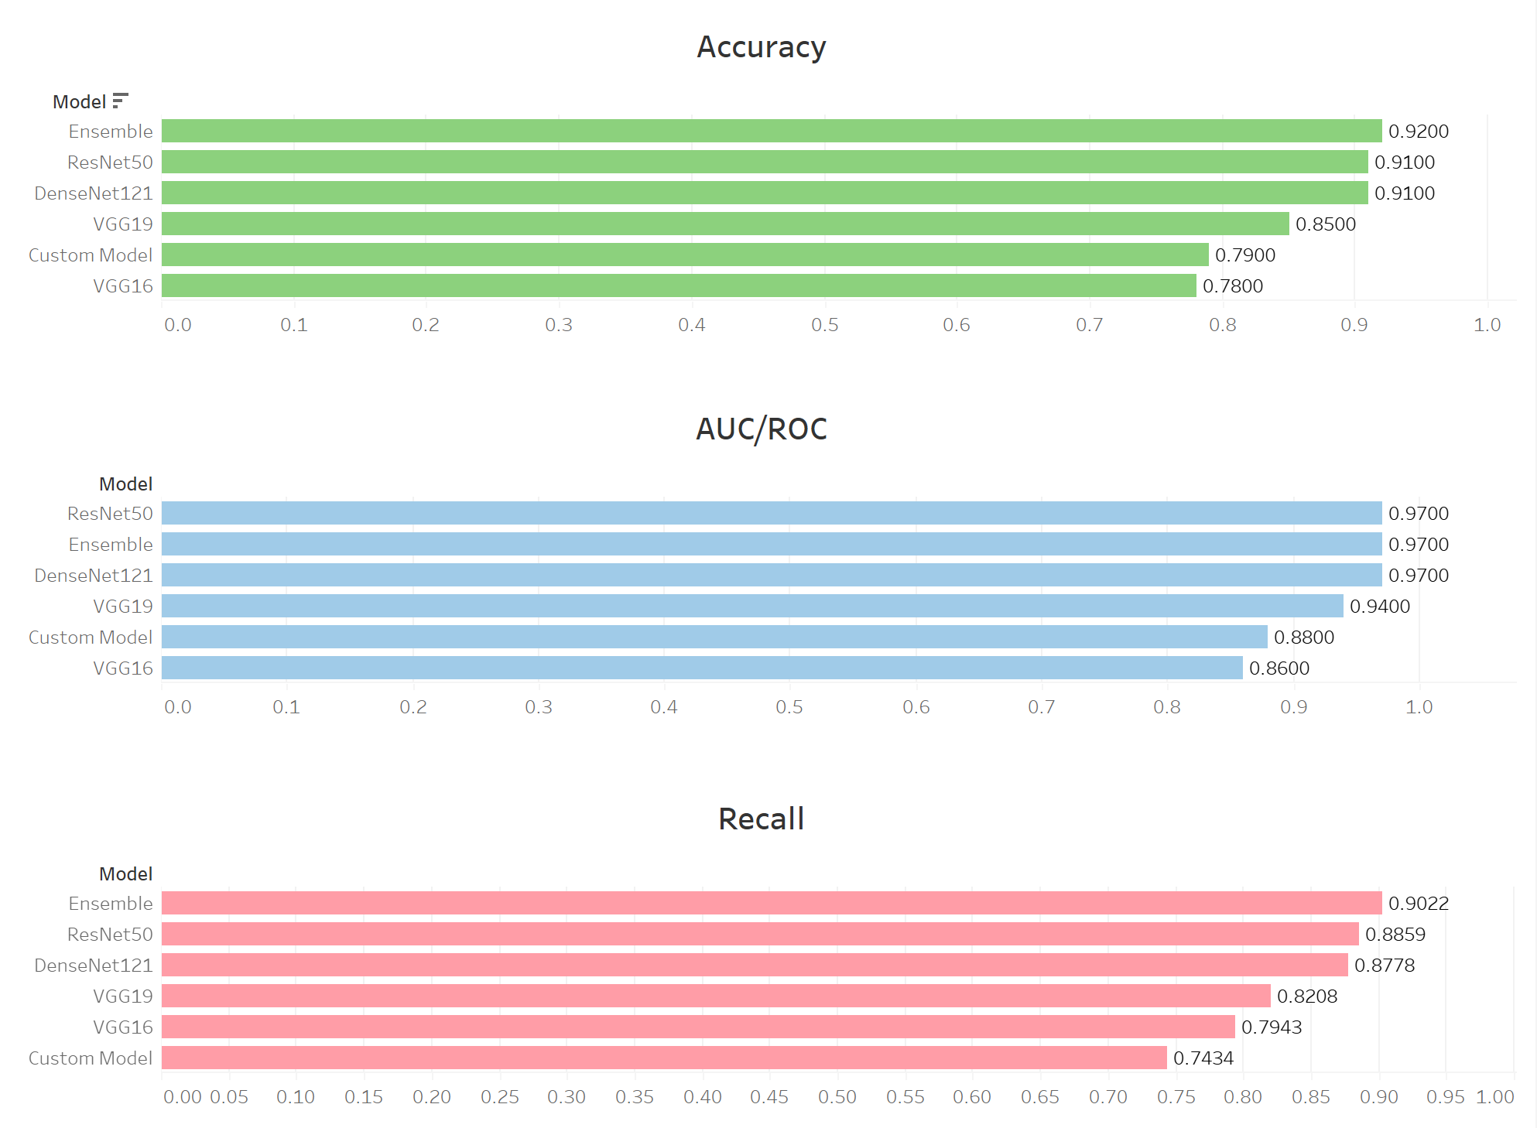

Slide 25
By SHASHANK GUPTA, DONGHUI LI, YINGJUN ZHONG, YUQING ZHENG, JAY TRIVEDI
THANK YOU!
HISTOPATHOLOGIC CANCER DETECTION

